Slide 1
Guardian of Health Safety

Slide 2

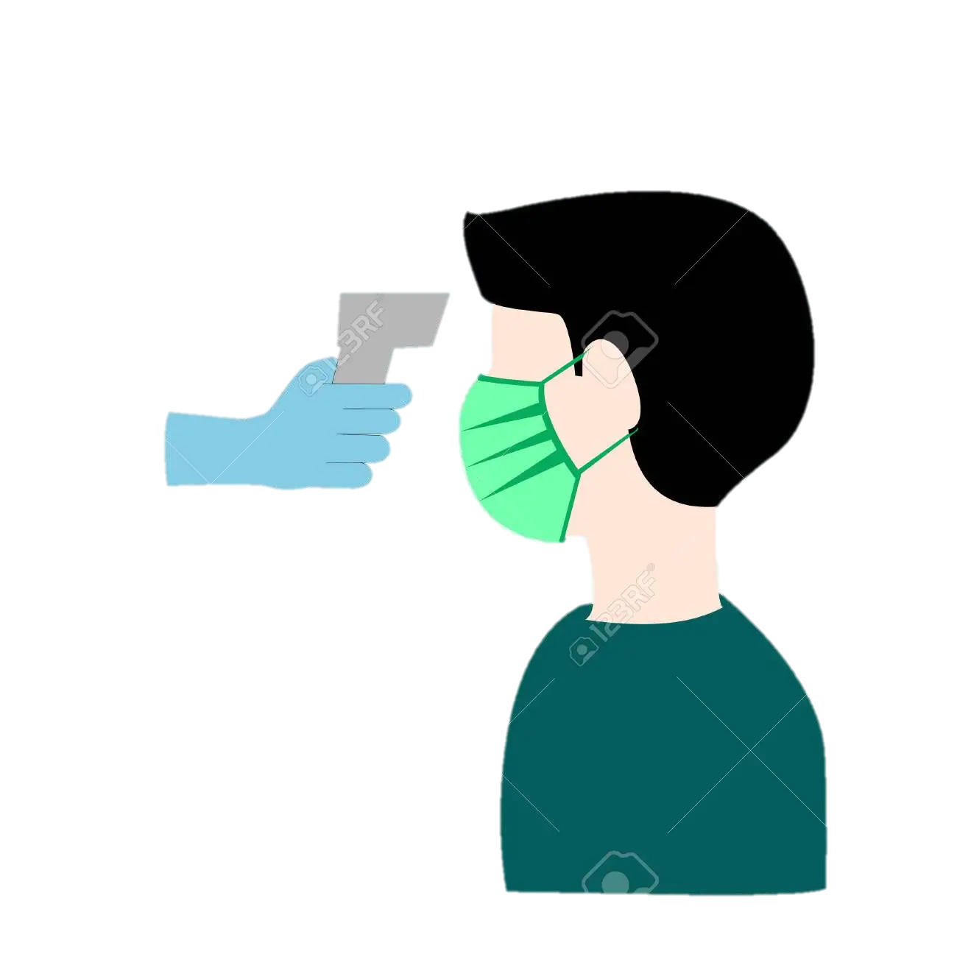



Project Concept
01
Detect Temperature
Case: 01
Case: 01
02
03
Temp: 96°F-99°F
Washed Hand
Request to Wash Hands
Chance to Get In
Didn’t
Washed Hand
Case: 02
03
Temp: 100°F or
up to 100°F
Case: 02
Request to Return
02
Request to Return

Slide 3

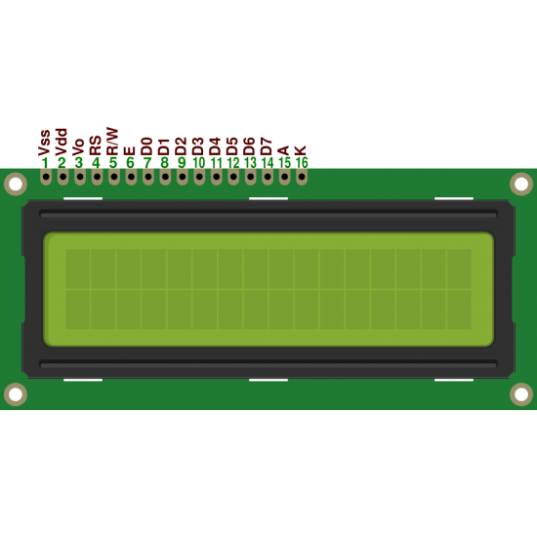
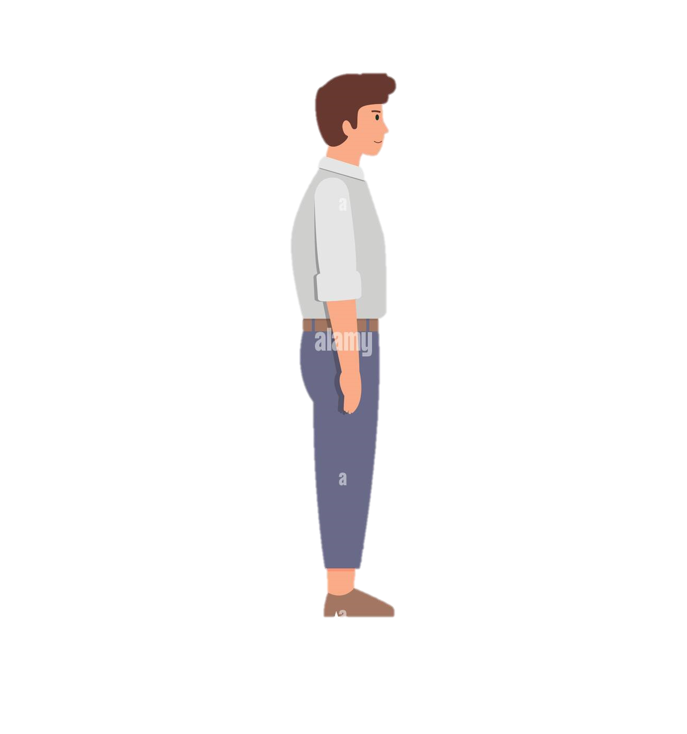



How Our System Works
Temp: 98°F
Wash Hand
Please Enter
Temp: 101°F
Didn’t Wash Hand
May Covid Positi
Time Out !
Please Return
Please Return

Slide 4

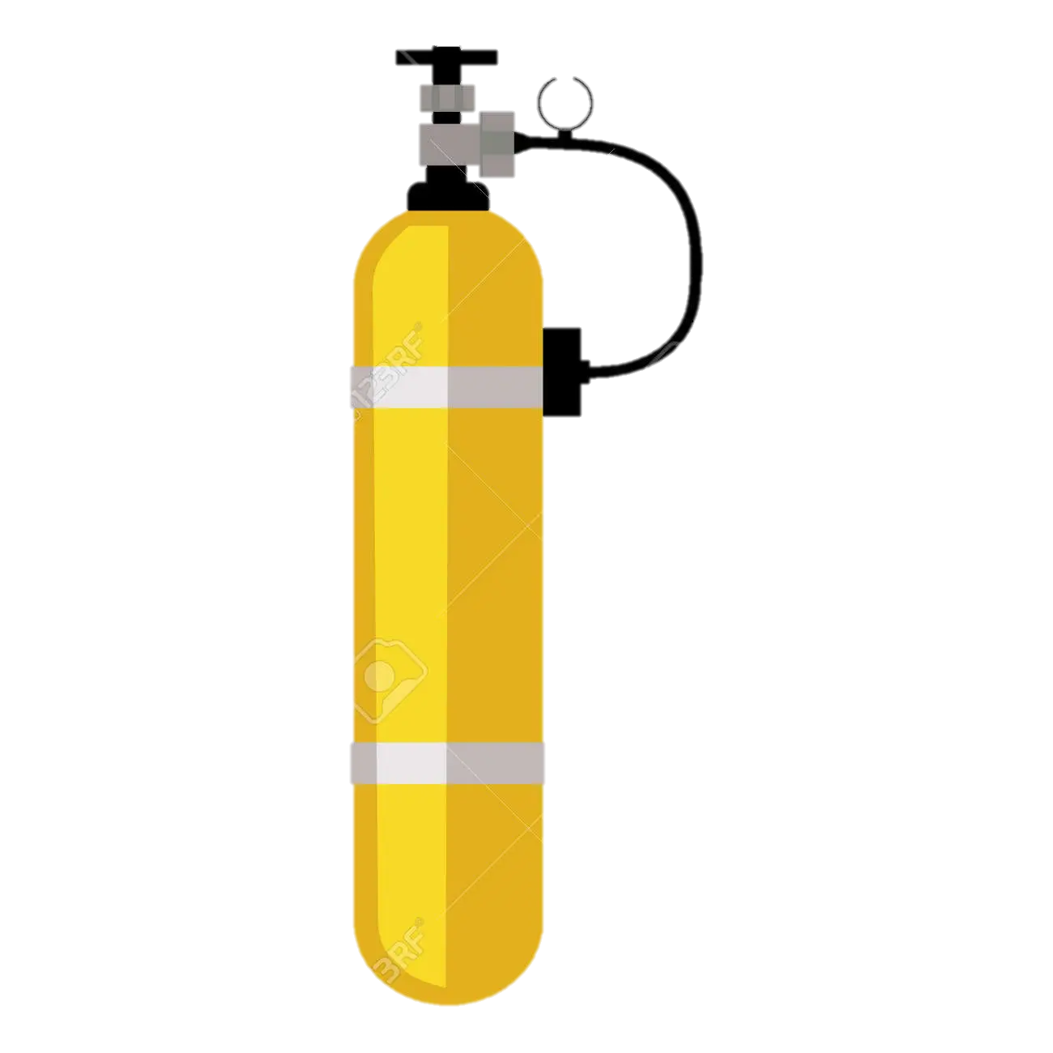


Motivation
High Transmission
Easy Transmission
Deficit of Health
Stuffs

Slide 5
Advantages
01
03
02
Efficiency
Budget
Activity
Highly efficient to detect temperature
Very cheap to purchase
Allow to enter after cleaning hand

Slide 6
Goals
02
01
03
Available for market
Make more efficient
Add more features

Slide 7

WELCOME
Sakir Hossain Faruque
Contribute to
develop the project

Slide 8
PARTICIPANT REVIEWS
Sabit
Md. Mahfuj Sarker
Very nice concept. Well done!
Very nice work! Keep it up!
--Polash
This project is so good.i.Good idea. keep it up,
Safety caution idea. Very helpful for the future epidemic situation

